Slide 1
Breadth-First Search Depth-First Search
Zhicheng Gu

Slide 2
Definition
Breadth-first search (BFS) is a search algorithm which starts from the first place and explores the neighbor places first. Then move to the next level neighbors.

Slide 3
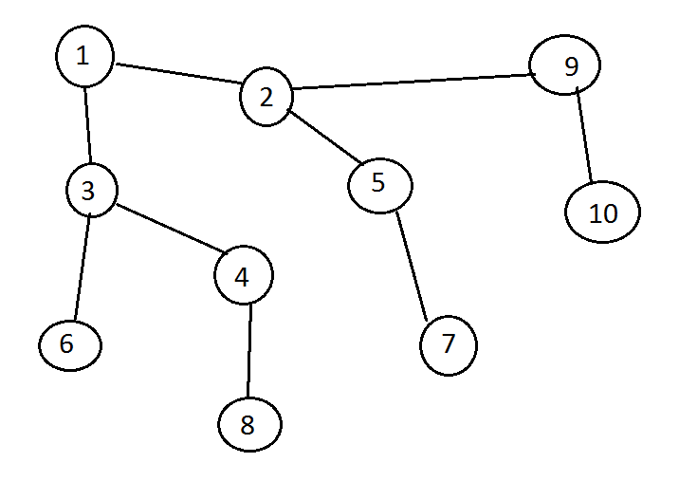
Breadth-First Search (BFS)

Slide 4
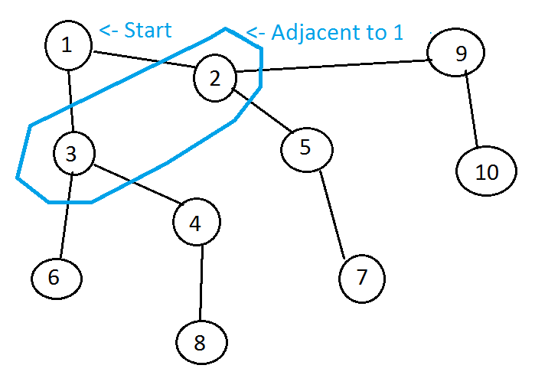
Breadth-First Search (BFS)

Slide 5
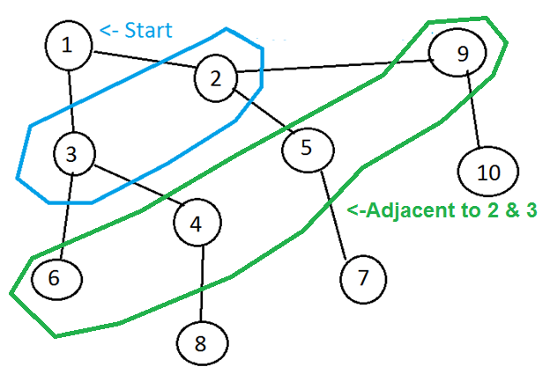
Breadth-First Search (BFS)

Slide 6
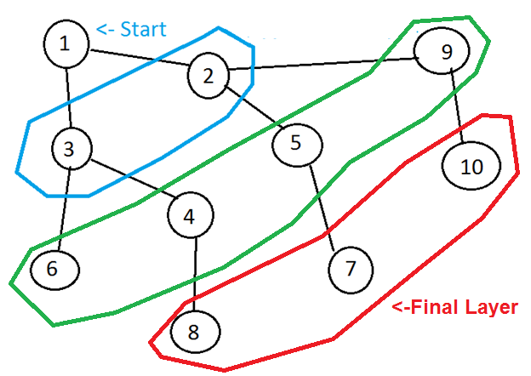
Breadth-First Search (BFS)

Slide 7
Definition
Breadth-first search (BFS) is a search algorithm which starts from the first place and explores the neighbor places first. Then move to the next level neighbors.
Depth-first search (DFS) is a search algorithm which starts at the first place and explores as far as possible along each branch before backtracking.

Slide 8
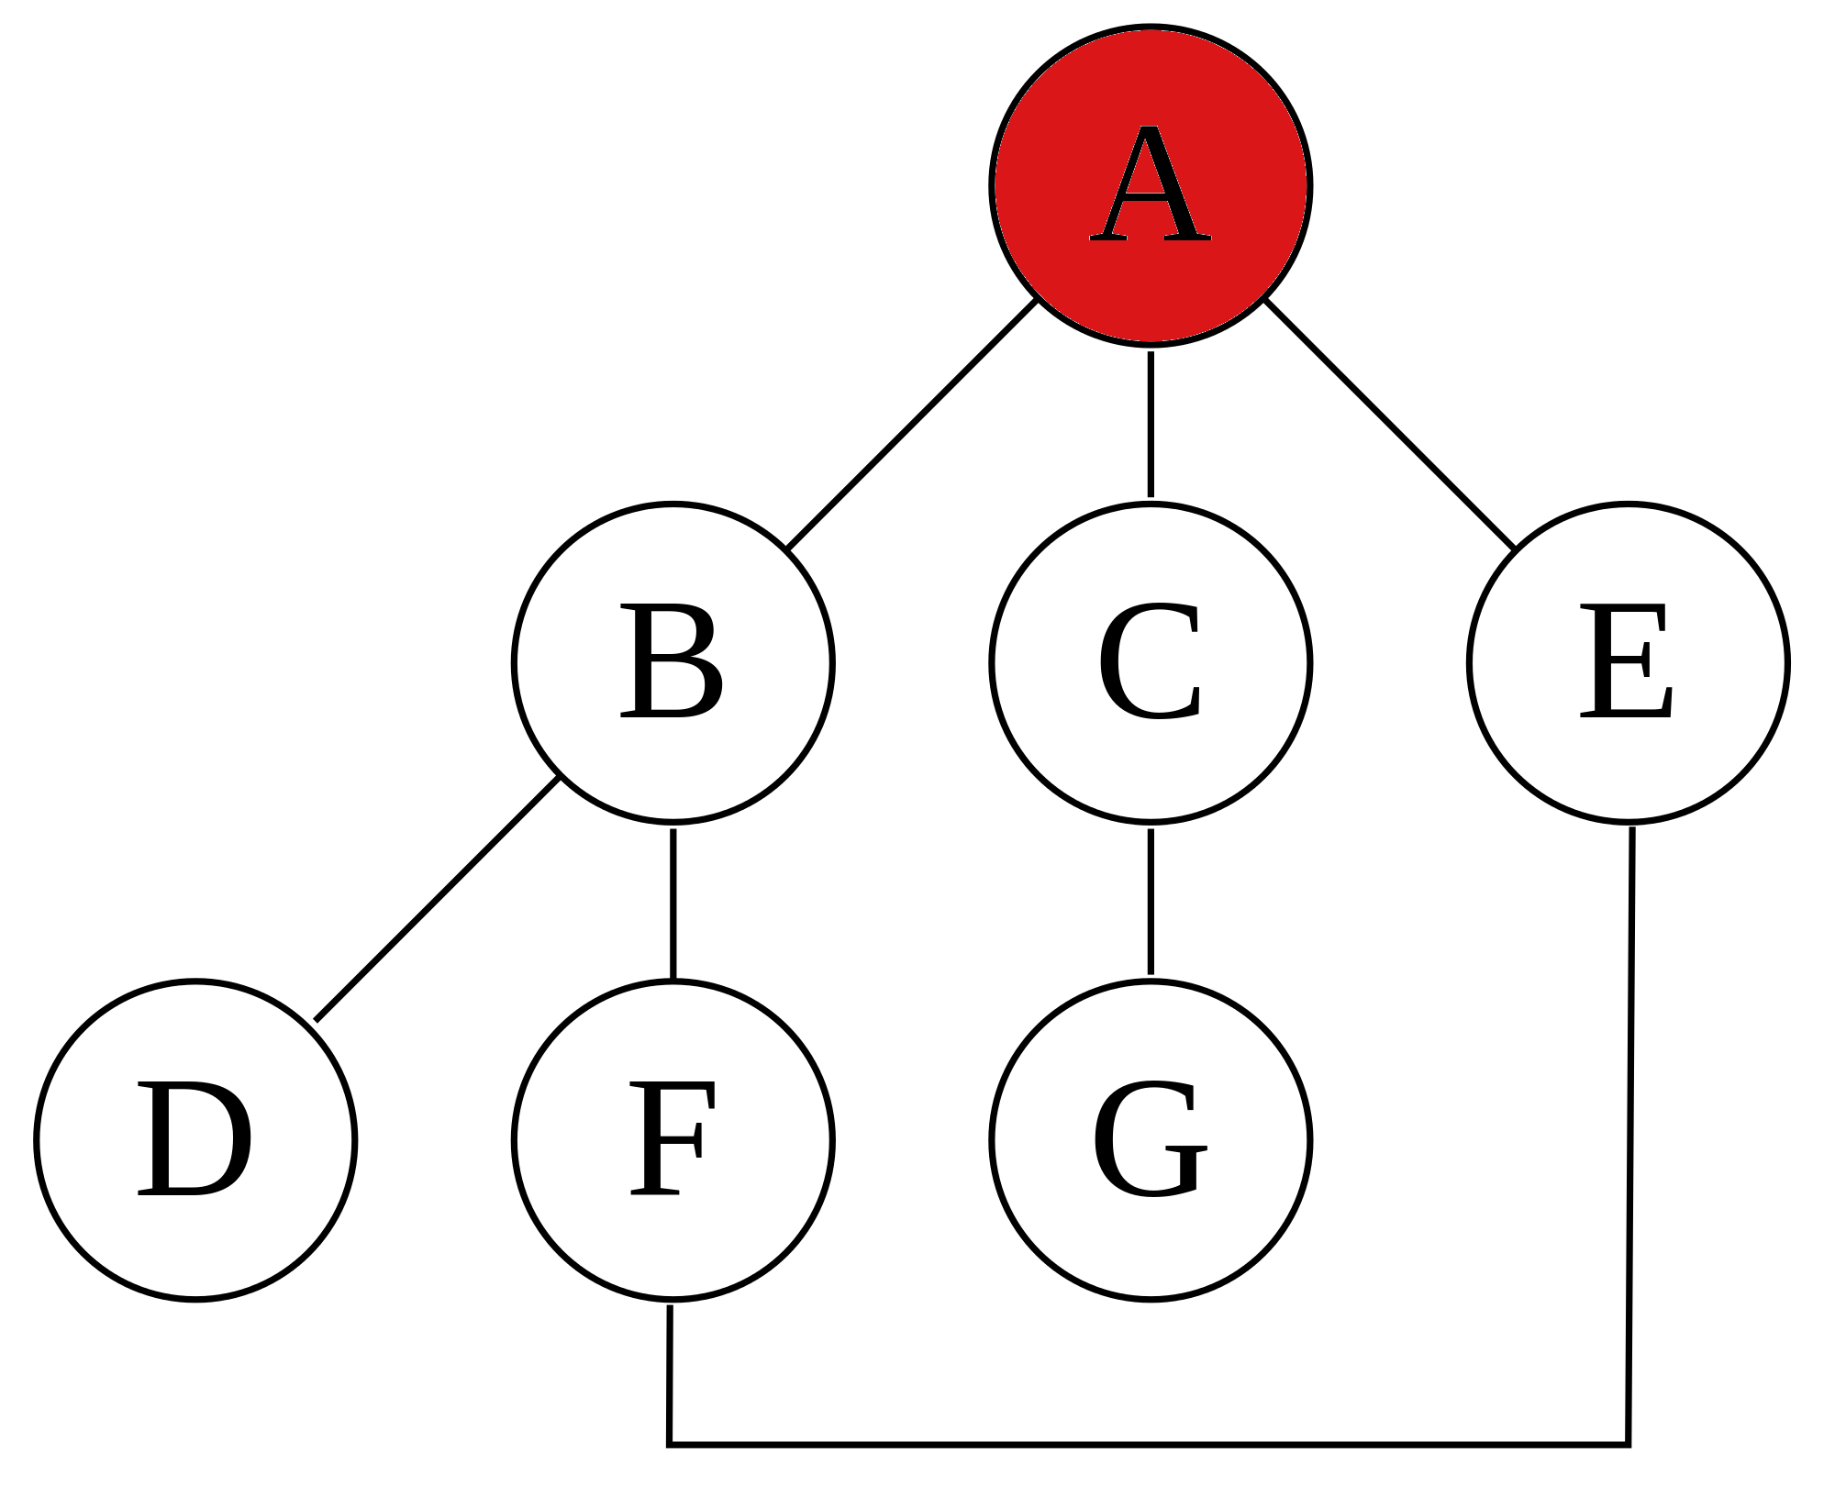
Depth-First Search (DFS)

Slide 9
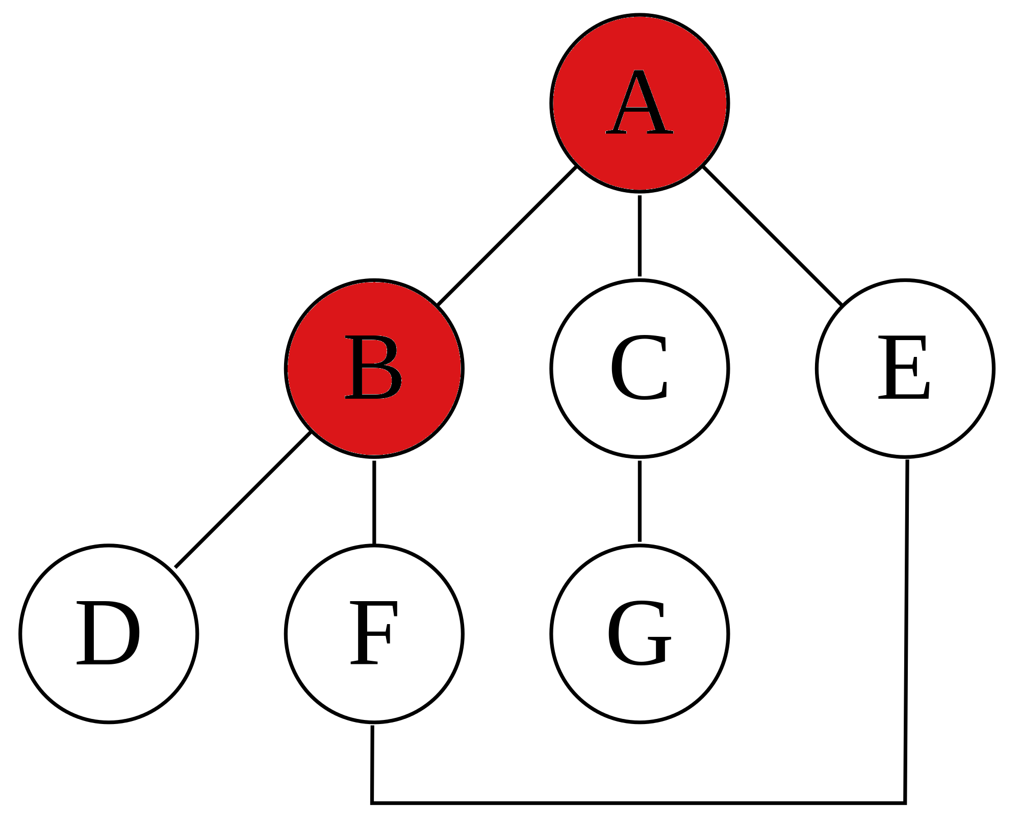
Depth-First Search (DFS)

Slide 10
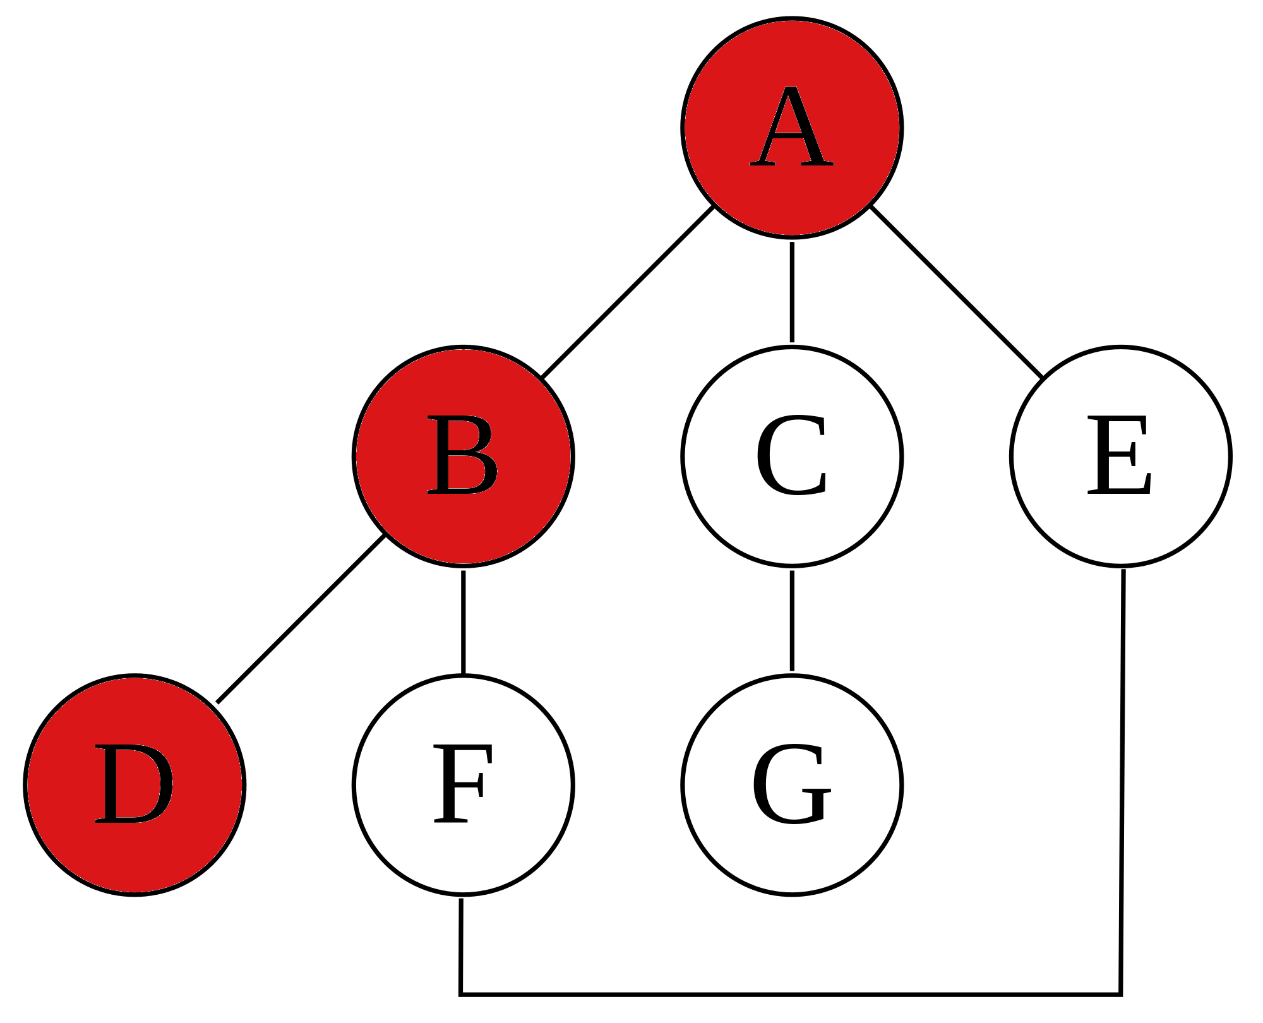
Depth-First Search (DFS)

Slide 11
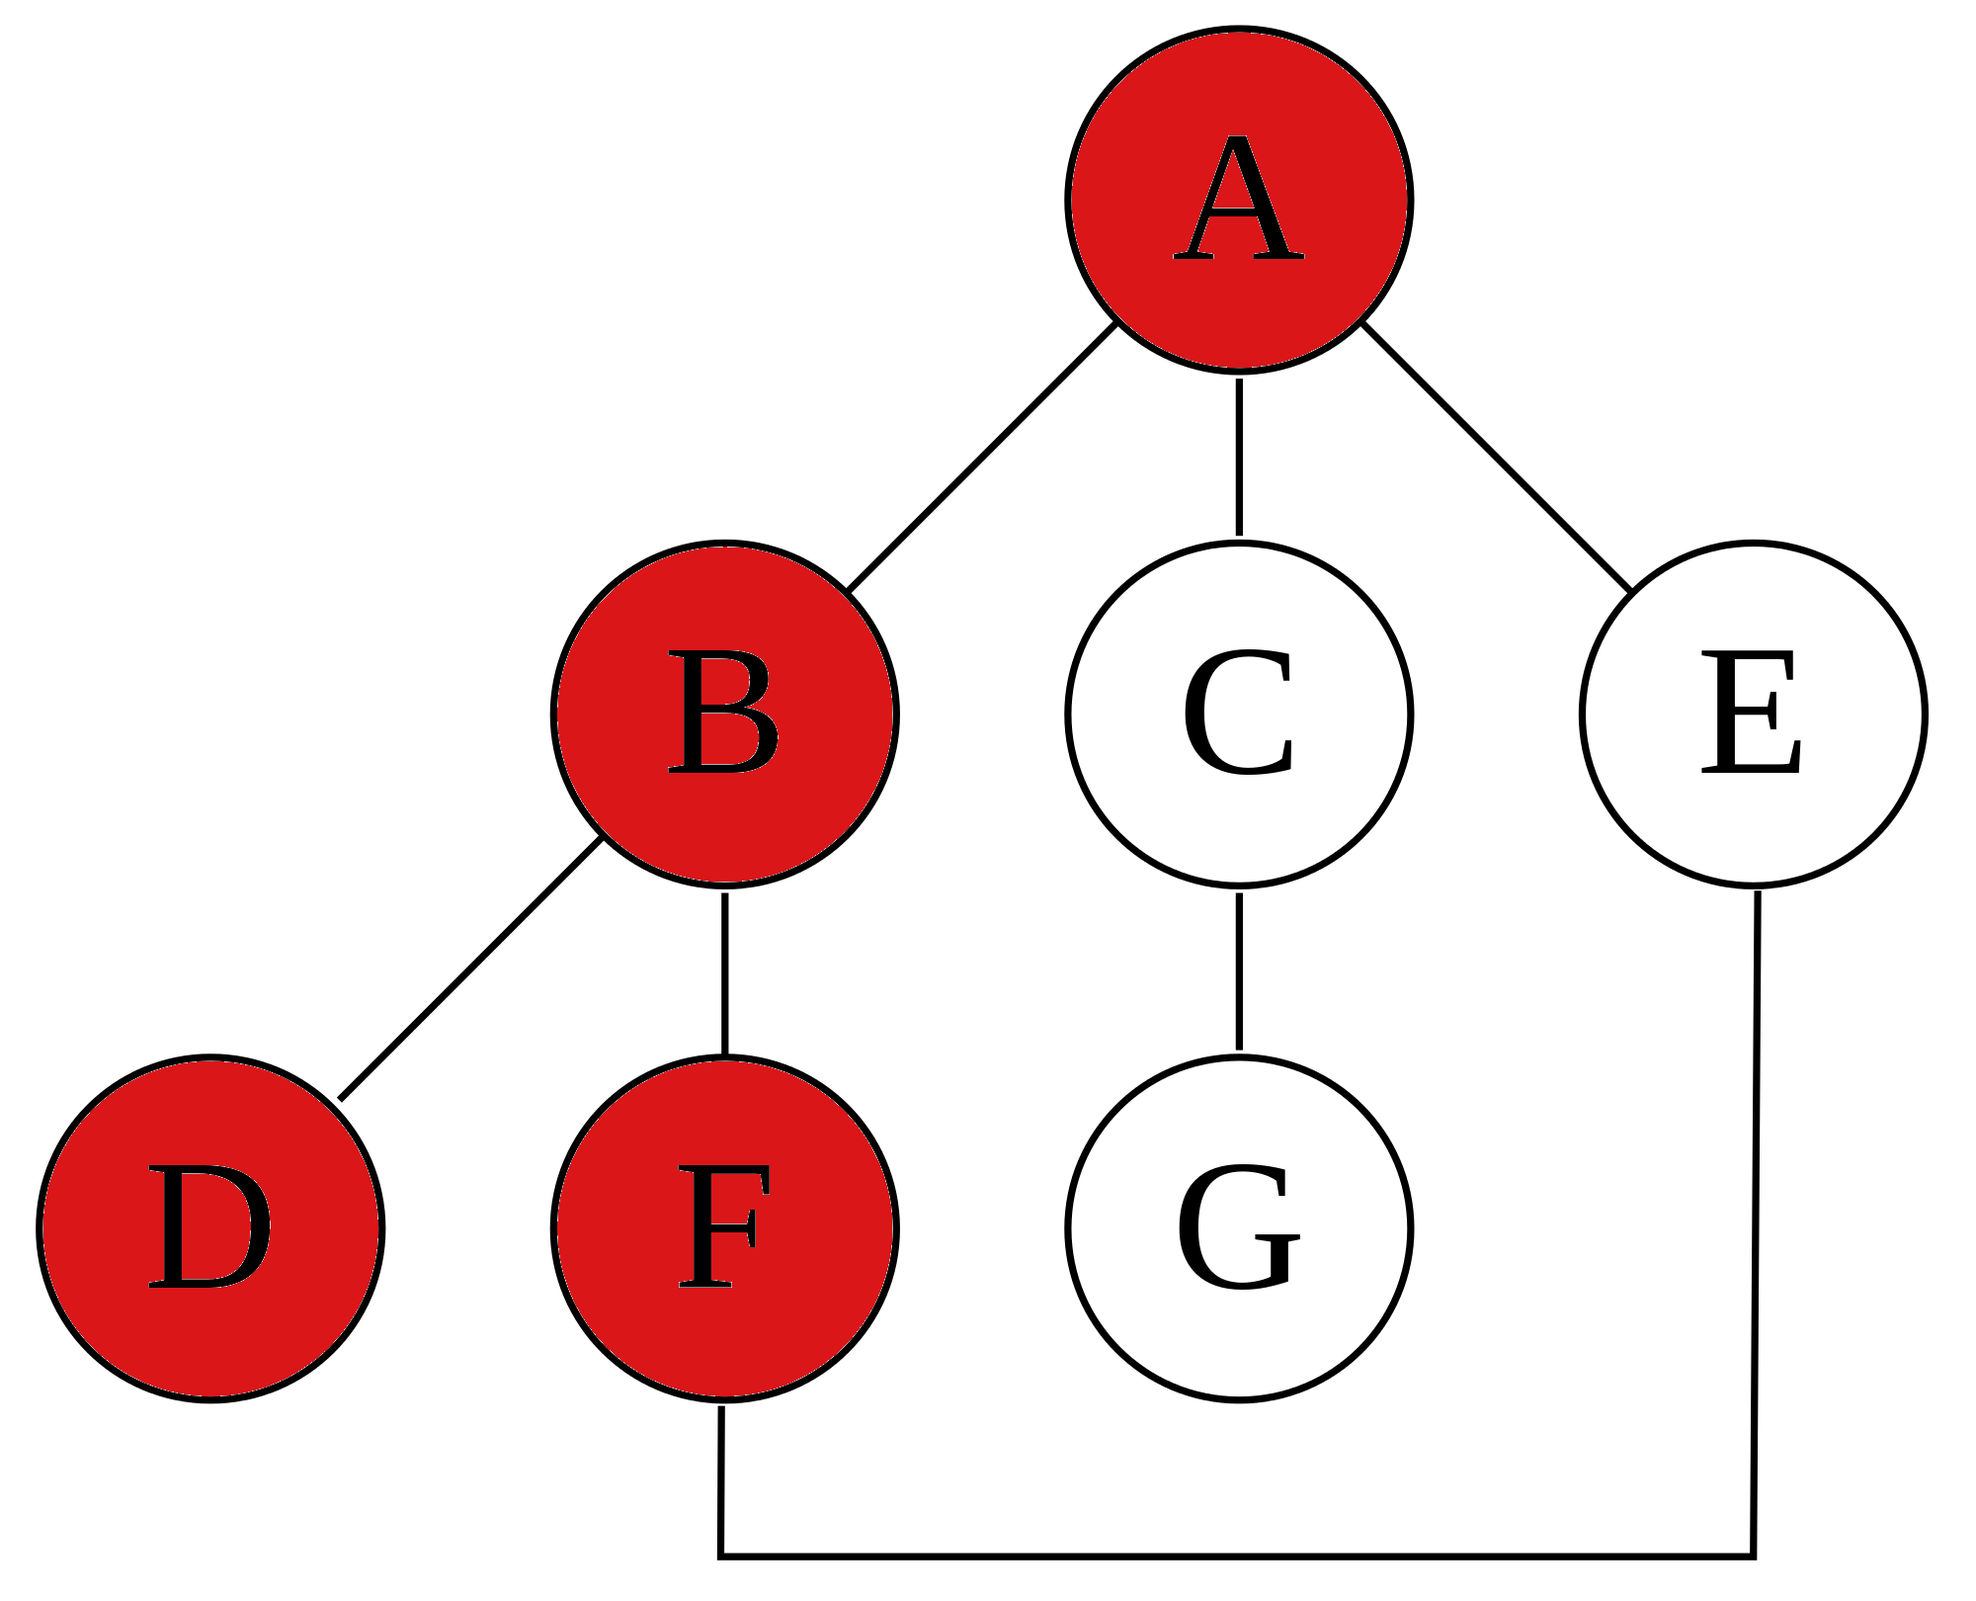
Depth-First Search (DFS)

Slide 12
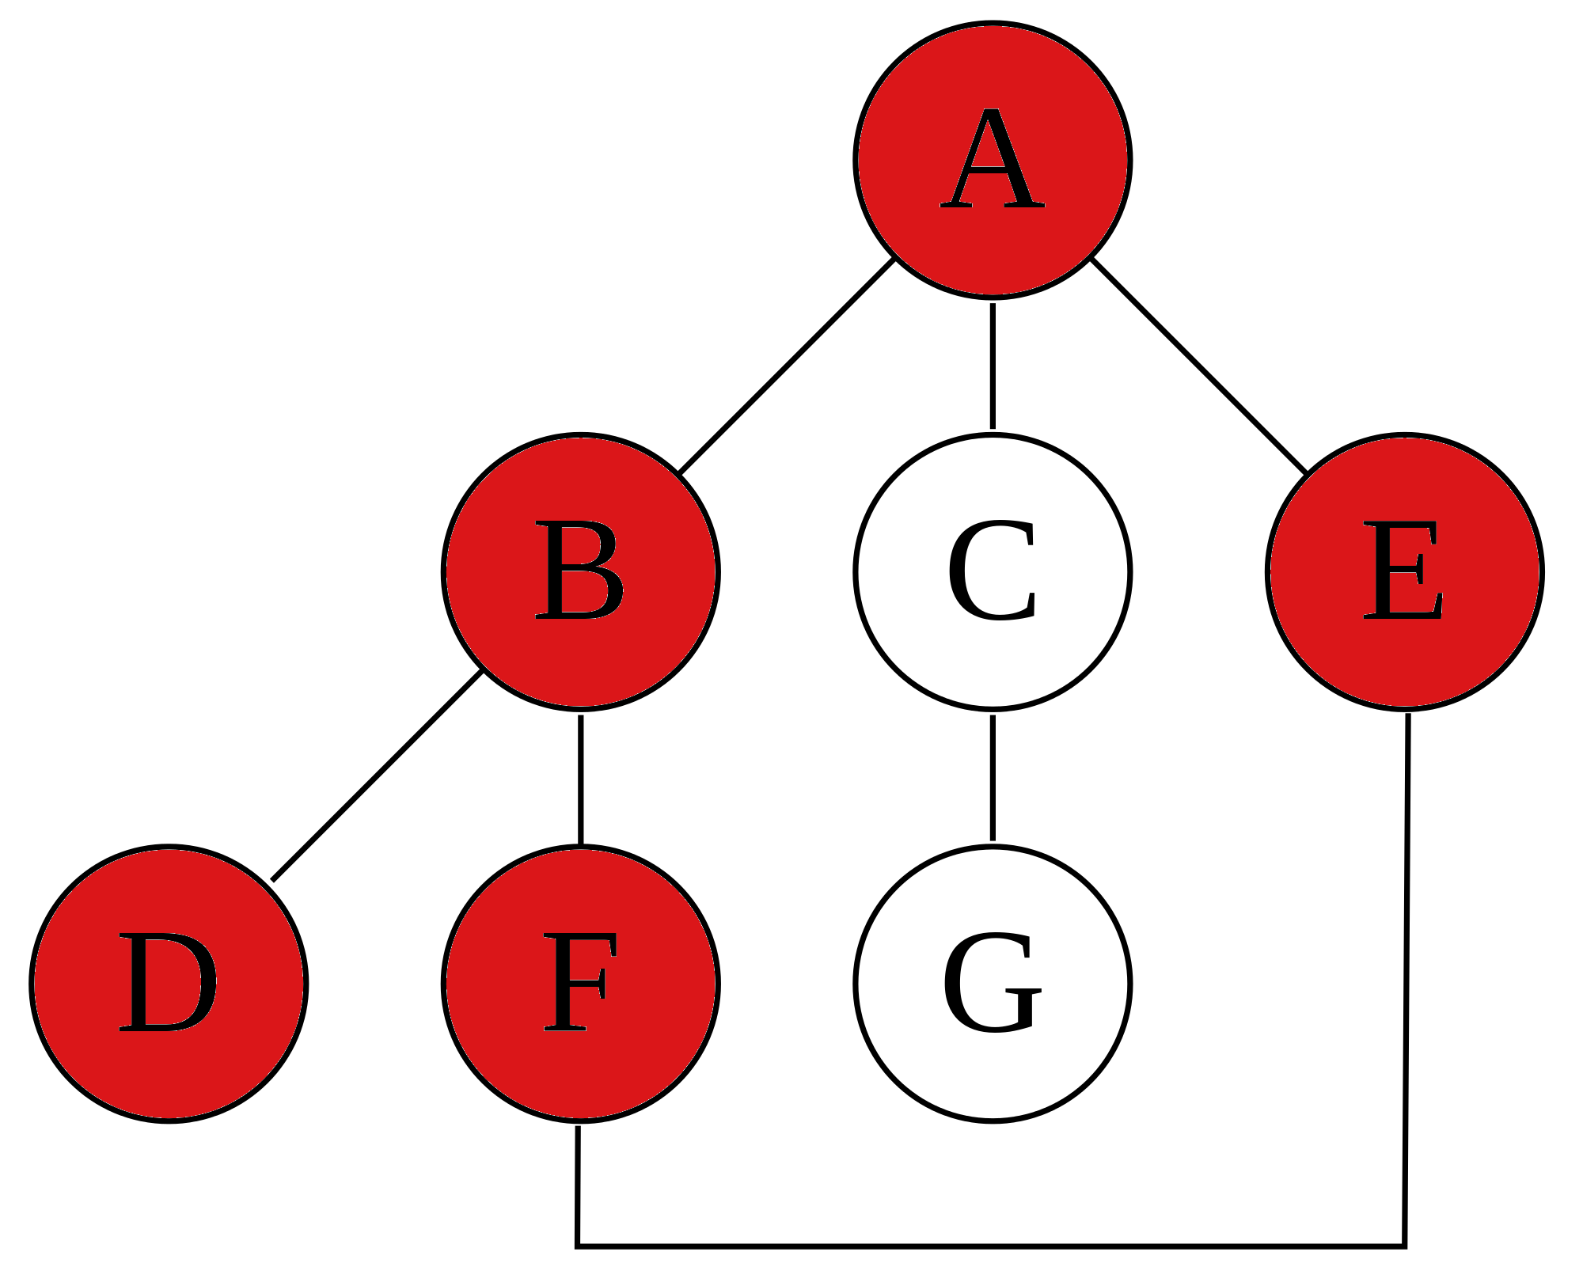
Depth-First Search (DFS)

Slide 13
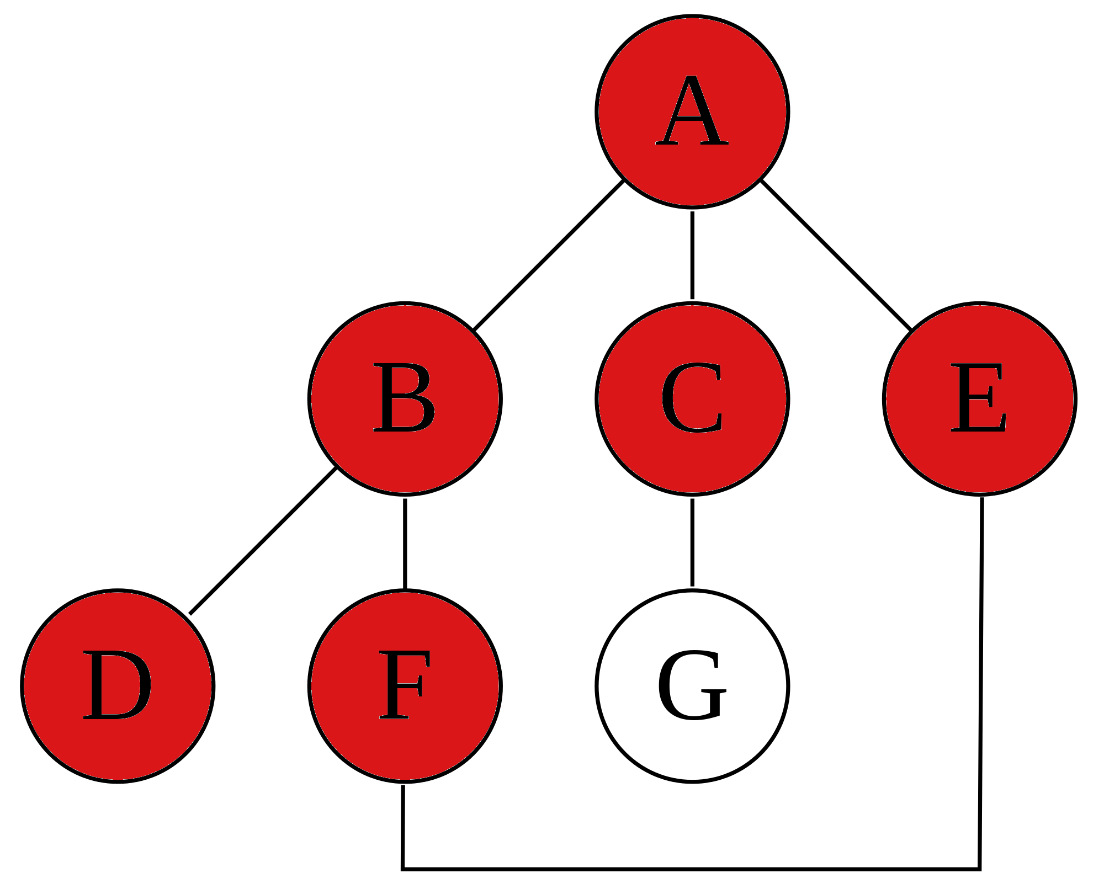
Depth-First Search (DFS)

Slide 14
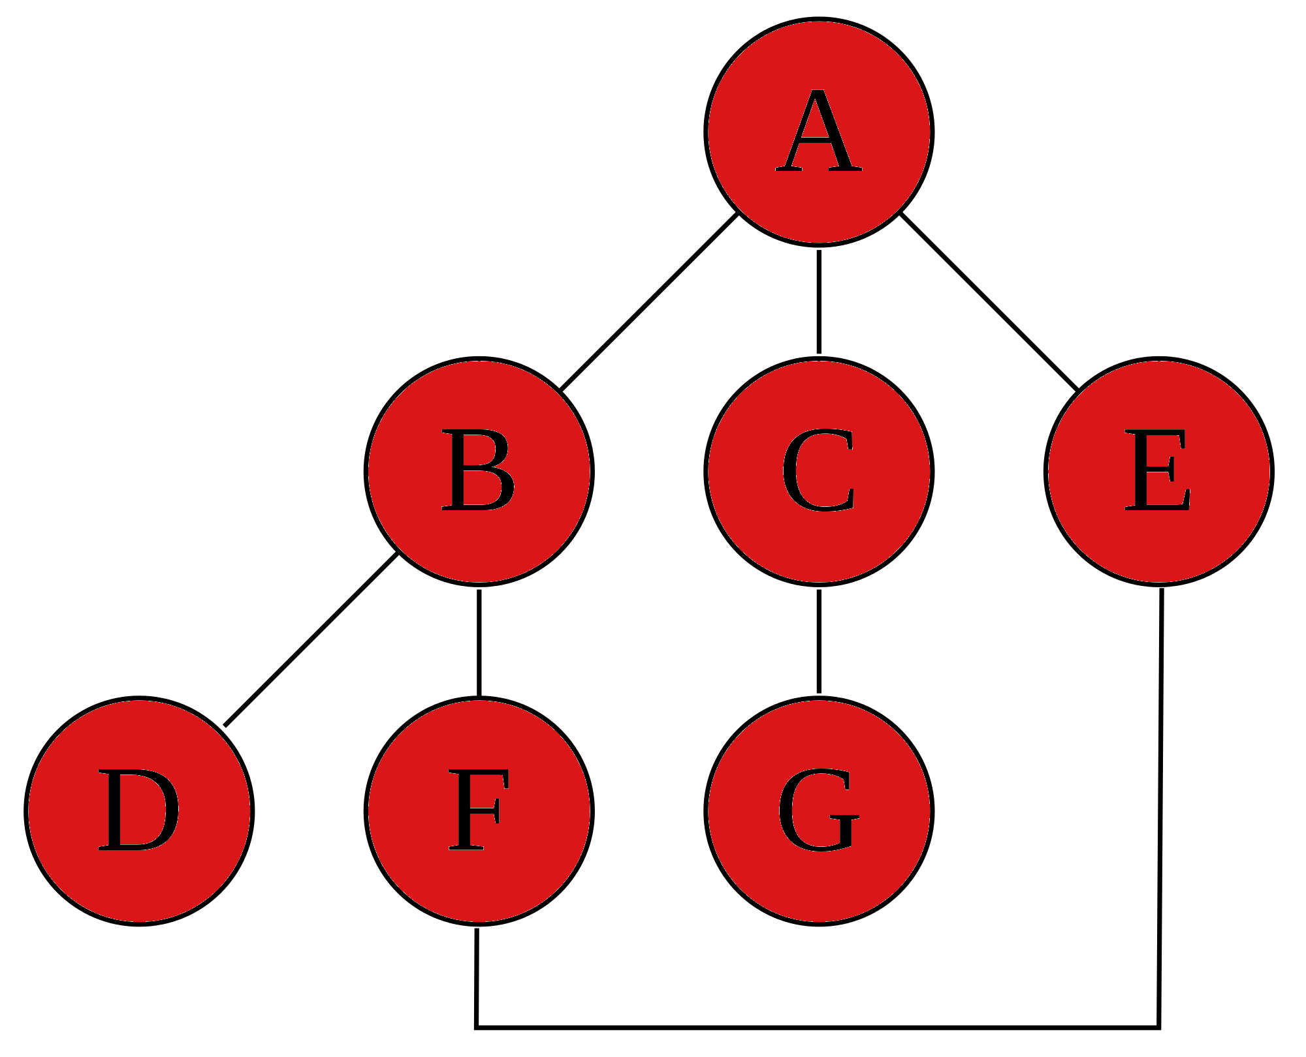
Depth-First Search (DFS)

Slide 15
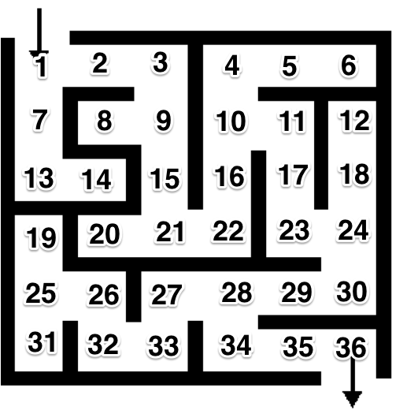

Slide 16
BFS vs. DFS

Slide 17
BFS vs. DFS
Find the shortest path.
Require more memory.
Find a general path.
Require less memory.

Slide 18
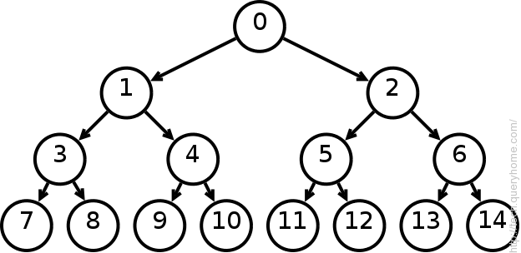
BFS vs. DFS
Find the shortest path.
Require more memory.
Find a general path.
Require less memory.

Slide 19
Use BFS or DFS?
GPS Navigation systems
Solve a maze
Solve a very big maze

Slide 20
Use BFS or DFS?
GPS Navigation systems
BFS
Solve a maze
BFS/DFS
Solve a very big maze
DFS

